Slide 1
THIRD YEAR T.D.C., SCIENCE PAPER-III, Part E Paper Code - 3163
SOLID STATE, NUCLEAR
AND PARTICLE PHYSICS

Slide 2
UNIT – 1 : CRYSTALLOGRAPHY
BLOCH FUNCTIONS: I. Free Electron Model
Before going on to the Bloch Functions, we have to first look at the wave nature of electrons in a crystal. The simplest way to do this is by understanding the wave nature of free electrons in crystals
According to the free electron model, the most weakly bound electrons in a constituent atom are able to move freely throughout the material and the ions do not affect it.
The total energy therefore is only the kinetic energy and the potential energy can be neglected since it is assumed to be completely uniform and so does not affect (change) the energy of the electron.
These electrons, called conduction electrons in metals are responsible for the electrical conductivity in metals.

Slide 3
UNIT – 1 : CRYSTALLOGRAPHY
I. Free Electron Model
But even in metals, this model does not explain paramagnetic susceptibility of conduction electrons, heat capacity, occurrence of long electronic free paths etc.
To explain these affects, quantum mechanics has to be invoked and the concept of matter waves has to be introduced
Lattices have a periodic structure and matter waves propagate freely in a periodic structure
In this model, we consider the wave nature of electrons

Slide 4
UNIT – 1 : CRYSTALLOGRAPHY
I. Free Electron Model
Using this approach, each electron can be represented by a wave function Ψ which is a function of position and time such that Ψ*Ψ represents the probability of finding the electron at that particular position at that particular time.
This wave function is then used in the Schrödinger equation
In quantum mechanics, the Schrödinger equation plays the role of Newton’s laws of motion and law of conservation of energy in classical mechanics
It thus predicts the future outcomes of a dynamic system but unlike in the classical sense, it does so in terms of probabilities of outcomes

Slide 5
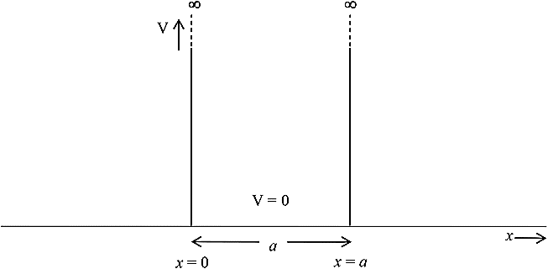
UNIT – 1 : CRYSTALLOGRAPHY
I. Free Electron Model : Electrons moving in a One-Dimensional Potential Well
For purposes of simplicity, consider an electron within a one-dimensional crystal of length a
In the Figure the crystal lies along the X-axis
The potential energy everywhere within this crystal is assumed to be constant and equal to zero. This means that in this model we assume that the ions (or nuclei) play no role in deciding the movement of electrons
At the two ends of the crystal, a very high potential energy barrier, V0 = ∞, prevents the electron from leaving the crystal.

Slide 6
UNIT – 1 : CRYSTALLOGRAPHY
------------------ Eq.1
I. Free Electron Model : Electrons moving in a One-Dimensional Potential Well
The conditions for the potential V(x) is given by:
Thus in a crystal, the Schrodinger equation for an electron of mass m becomes :
------------------- Eq.1

Slide 7
UNIT – 1 : CRYSTALLOGRAPHY
------------------ Eq.1
I. Free Electron Model : Electrons moving in a One-Dimensional Potential Well
A Simple periodic function which will satisfy this equation is:
A and B are arbitrary constants which can be determined by applying the boundary conditions.
Here we are considering an electron which is bound inside a crystal of length a and so the electron wave function has to satisfy two boundary conditions simultaneously
$$ψ\left(x\right)=A\sin{kx}+B\cos{kx}$$
------------------- Eq.2

Slide 8
UNIT – 1 : CRYSTALLOGRAPHY
I. Free Electron Model : Electrons moving in a One-Dimensional Potential Well
$$ψ\left(x\right)=A\sin{kx}+B\cos{kx}$$
------------------- Eq.2
The First Boundary Condition is:
From Equation 2 we see that when x=0, sin (kx) goes to 0, while cos(kx)=1. So this means that for Ψ=0 at x=0, the constant B has to be 0
(i) Ψ=0 at x=0

Slide 9
UNIT – 1 : CRYSTALLOGRAPHY
I. Free Electron Model : Electrons moving in a One-Dimensional Potential Well
$$ψ\left(x\right)=A\sin{kx}+B\cos{kx}$$
------------------- Eq.2
The Second Boundary Condition is:
But we have seen that by the first boundary condition, B is already 0. So this means that $A\sin{ka}=0$
Now A cannot be zero since if both constants are zero, Ψ is always equal to zero.
(ii) Ψ=0 at x=a

Slide 10
UNIT – 1 : CRYSTALLOGRAPHY
I. Free Electron Model : Electrons moving in a One-Dimensional Potential Well
$$ψ\left(x\right)=A\sin{kx}+B\cos{kx}$$
------------------- Eq.2
This means that $\sin{ka}=0$ or $k=\frac{nπ}{a}$
Here, n is an integer number=1, 2, 3…..
n cannot be zero since this again means that Ψ=0 everywhere in the box
In slide No. 4 we have mentioned that Ψ*Ψ describes the probability of finding the electron at that particular position at that particular time. So if Ψ=0 everywhere in the box (when n=0), this means that the electron is not present

Slide 11
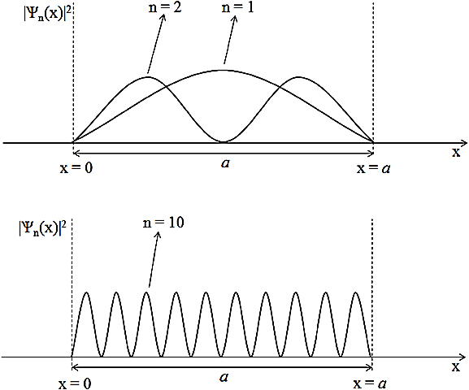
UNIT – 1 : CRYSTALLOGRAPHY
I. Free Electron Model : Electrons moving in a One-Dimensional Potential Well

Slide 12
UNIT – 1 : CRYSTALLOGRAPHY
I. Free Electron Model : Electrons moving in a One-Dimensional Potential Well
The solution to the Schrodinger wave equation (Eq. 1) for the region
0 < x < a is : $Ψ_{n}=A\sin{\frac{nπx}{a}}$ ------------------- Eq.3
⇒ For each value of n, there is a corresponding quantum state $Ψ_{n}$ with an energy E_{n}
In other words, the electron cannot have any value of energy and the energies are quantized.

Slide 13
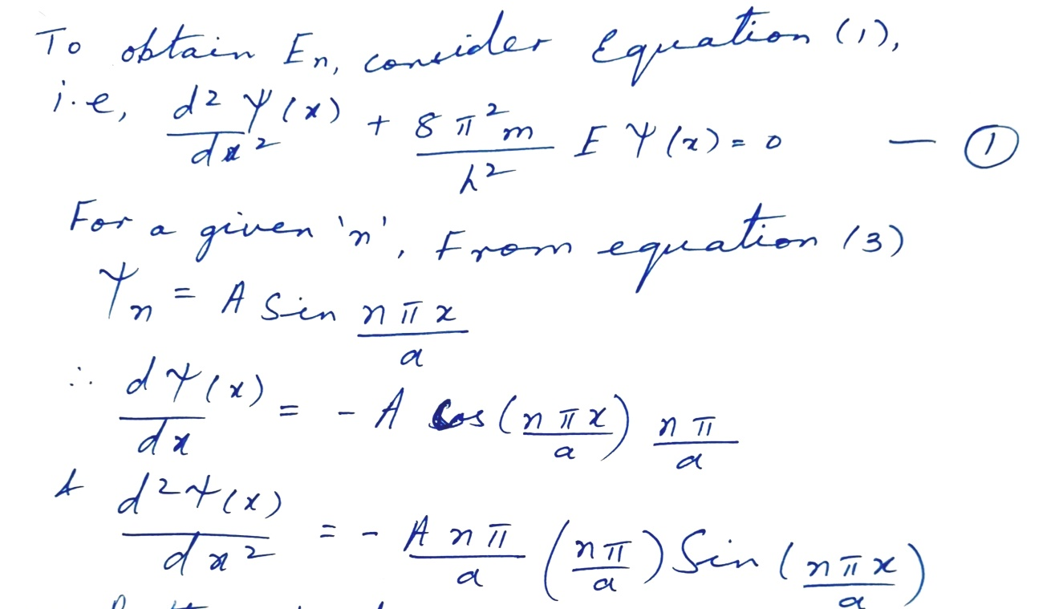
UNIT – 1 : CRYSTALLOGRAPHY
I. Free Electron Model : Electrons moving in a One-Dimensional Potential Well
Expression for E_{n}

Slide 14
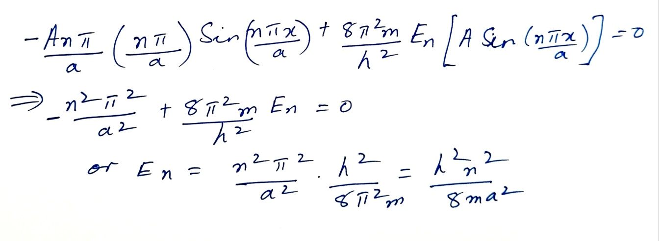
UNIT – 1 : CRYSTALLOGRAPHY
I. Free Electron Model : Electrons moving in a One-Dimensional Potential Well
Expression for E_{n}
Putting these terms back into (1), we get,
Thus we can see that bound electrons can have only discrete values of energy. The lowest energy is when n=1 or,
$E_{1}=\frac{h^{2}}{8ma^{2}}$
and any $E_{n}=n^{2}E_{1}$

Slide 15
UNIT – 1 : CRYSTALLOGRAPHY
Bloch Functions and Bloch Theorem
The free electron model which we have considered above explains phenomena such as electrical conductivity, thermionic emission etc. which the classical model could not.
However, it cannot explain why some materials are good electrical conductors, semiconductors or insulators.
In the free electron model, we assumed that the electron is in an infinite square well potential in which the electron sees the same (zero) potential from one boundary to the other.

Slide 16
UNIT – 1 : CRYSTALLOGRAPHY
Bloch Functions and Bloch Theorem
In the free electron model, the role of the ions (nuclei) was neglected.
But actually the bottom of the well not flat; the nuclei (positive ions actually) create potential wells that are periodic within the box

Slide 17
UNIT – 1 : CRYSTALLOGRAPHY
Bloch Functions and Bloch Theorem
The periodic potential V(x) can be defined using the lattice constant a as:
Using this type of a periodic potential, Bloch showed that the one dimensional solution of the Schrodinger equation is:
$Ψ\left(x\right)=\exp\left(ikx\right)u_{k}\left(x\right)$ ----------------------------------- Eq. (4)
In three dimensions, it becomes:
$Ψ_{k}\left(r\right)=\exp\left(ik.r\right)u_{k}\left(r\right)$ --------------------------------- Eq. (5)
V(x) = V(x+a)

Slide 18
UNIT – 1 : CRYSTALLOGRAPHY
Bloch Functions and Bloch Theorem
The expressions in Eq.(4) and (5) are the Bloch functions in one and three dimensions respectively.
They represent the free electron wave modulated by the periodicity of the lattice through periodic functions
$u_{k}(x)$ (for 1 dimension) or $u_{k}(r)$ (for 3 dimensions)

Slide 19
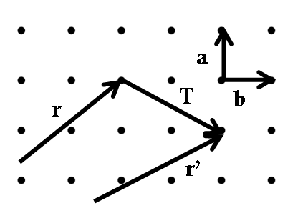
UNIT – 1 : CRYSTALLOGRAPHY
Bloch Theorem
Bloch’s theorem gives a method to describe the wave function for periodic solids. It places constraints on ψ and therefore also for the values of E for periodic solids
Since the solid is periodic at the atomic scale, a traveling wave solution ($\exp\left(ik.r\right)$) for ψ that is modulated by the translational symmetry of the lattice ($u_{k}(r)$) is obtained
So, in the Bloch function given by equation (5),
$Ψ_{k}\left(r\right)=\exp\left(ik.r\right)u_{k}\left(r\right)$,
$u_{k}\left(r\right)= u_{k}\left(r+T\right)$
Here, T is the translational vector which takes us from one lattice point to another (already explained in PPT Unit1A, see figure).
-1a
2b

